Slide 1
WELCOME BACK
I think you would all agree…
It’s been a strange few weeks since we left school on March 12th.
Did we ever imagine we would be in this space in 2020?
Social distancing… Quarantine… Isolation… Staying at Home… Actions we would usually avoid are now encouraged and forced upon us.
To be honest, it’s not easy. We can all feel vulnerable at times like these.
We need to mind ourselves.

Slide 2
Chaplaincy in Coláiste Cholmcille is about being there for all in the school community; staff, students and their families.
While we may struggle with the challenges that lay ahead, we should take comfort in knowing that we will be reunited soon.
You are all in our thoughts and prayers daily.

Slide 3
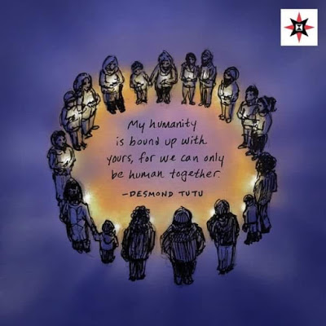
Keeping Calm The following are 5 Ways to Wellbeing
Coláiste Cholmcille.
We are Community

Slide 4
1.TAKE NOTICE
Remember the simple things that give you joy.
Cook. Bake. Draw. Sing. Dance. Clean your room. Play a game. Eat.
Tick something off your to do list. Notice the sky, the flowers. Listen to the birdsong.
And at the end of each day try to think of 3 things you are grateful for.
Remember you are not STUCK at home, you are SAFE at home.

Slide 5
2. CONNECT
Spend time with those who are at home.
Use social media to stay in touch with friends and relatives.
Check in with those who you think might be struggling.
Pray- Why not use this time to explore or deepen your connection with GOD

Slide 6
3. BE ACTIVE
Do what you can to stay as active as possible.
Try a home workout – There are lots online.
Get some fresh air every day(within 2km) to improve your mood.

Slide 7
4. KEEP LEARNING
Embrace new learning experiences.
See opportunities to develop positive study habits.
Contact each other if you are struggling.
Try your best.

Slide 8
5.
The best things you can give right now are simple.
Stay at Home
Help your parents/guardians out around the house.
Do your school work and study as best you can.
Pray for our frontline workers, those who are ill and those who have been bereaved.

Slide 9
Remember Love= Sacrifice
“And then the whole world walked inside and shut their doors and said we will stop all, everything.
To protect our weaker ones,
Our sicker ones
Our older ones.
And nothing, nothing in the history of humanity, since the Lord gave his life for us on a cross,
Ever felt more like love than this”

Slide 12
KEEP GOING

Slide 13
Stay Safe
Stay Home
Stay Well.

Slide 15
Finally, be gentle with yourself and one another.
These are testing times but we can and we will get through this. If you are in need of advice or support please contact
pkilfeather@ccbs.ie or bkilfeather@ccbs.ie

